Slide 1
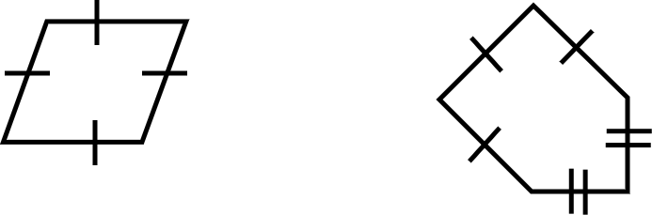
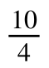
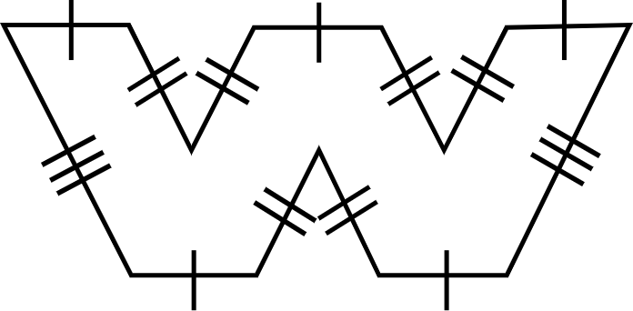
Calculating missing lengths with perimeter of polygons
Task A: Calculating unknown lengths
1) Calculate the lengths of the marked sides.
a) b)
c)
7 units
b
a
Perimeter = 10 units Perimeter = 25 units
a + a + a + a = 10
4a = 10
a =
a = 2.5
The length of the marked side is 2.5 units.
7 + 7 + 7 + b + b = 25
21 + 2b = 25
2b = 4
b = 2
The length of the marked side is 2 units.
c
9 m
5 × 4 + 2 × 9 + 6 × c = 74
20 + 18 + 6c = 74
38 + 6c = 74
6c = 36
c = 6
The length of the marked side is 6 m.
4 m
Perimeter = 74 m

Slide 2
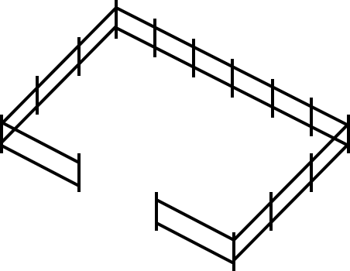
Calculating missing lengths with perimeter of polygons
Task B: Problems in context
1) Write your own problem using the same measures but in a different context.
Length = 90 m
Width = 45 m
Perimeter = 195 m
Answers will vary here but should all involve a perimeter of 270 m, a total known length of 195 m and an unknown length which equates to 75 m.
Mathematics in Education and Industry.

